Slide 1
Advanced shell programming

Slide 2
Shells and sub-shells
Running a shell script launches a new process, a subshell
A subshell is a child process launched by a shell.
#!/usr/bin/ksh
Here even the login shell is bourne it will use korn shell to execute the script

Slide 3
Exporting shell varibles
By default, the values in the shell variables are local to the shell and are not passed on to a child shell.
But the shell can also export these variables to child process, once defined they are globally available

Slide 4
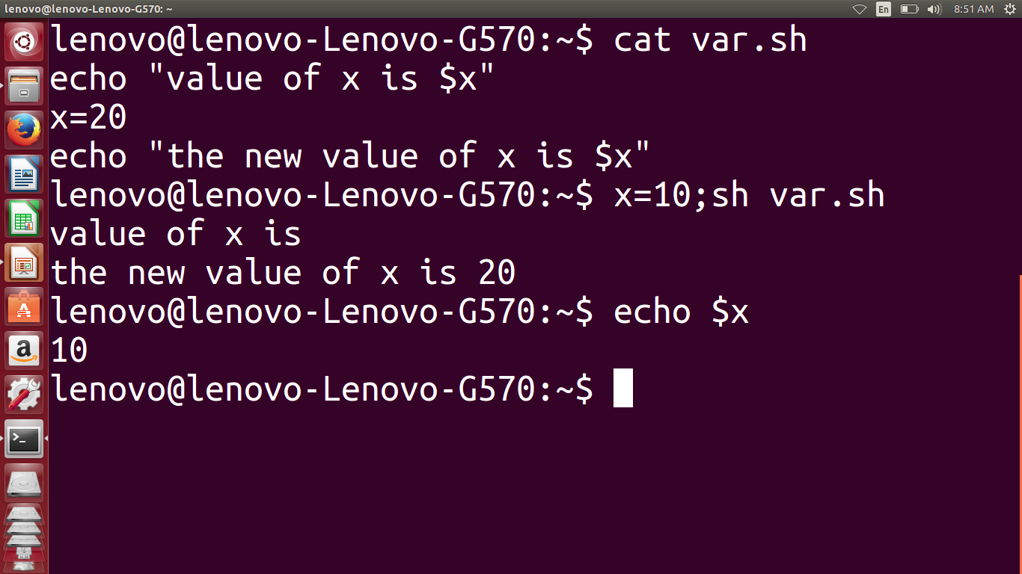

Slide 5
Exporting shell varibles
First assign 10 to x at the propmt and then execute
X=10; sh var.sh
Value of x is not visible to sub shell
To make x available gmobally, you need to use export statement before the script.

Slide 6
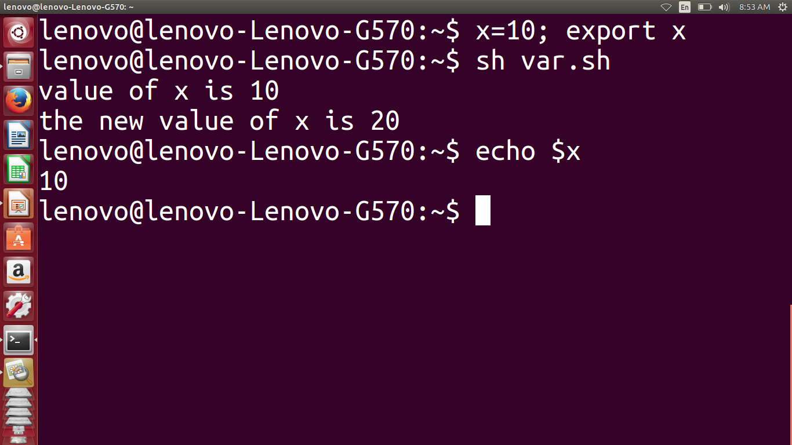

Slide 7
let
Use of let instead of expr.
$ let sum=256+289 #no whitespaces after variable
$ let sum=“256+893”
If you use whitespace , then quote the expression
$ let x=12 y=5 z=6
let z=x+y+$z
echo $z
23

Slide 8
let
Let permits you to get rid of the $ altogether when making assignment
Since it is built in it can work faster than expr

Slide 9
String handling
Length of the string: it is found by preceding the variable name with a #.
$ name=“vinton cerf”
echo ${#name}
11

Slide 10
Extracting a string
Using # and % u can extract a string
% symbol after the variable name deletes shortest string matching the contents at the end.
$ fqdn=java.sun.com
echo ${fqdn%%.*}
java

Slide 11
merging stream
echo “ none of the pattern found” 1>&2
Send the standard output to the destination of standard error.
Since the default file descriptor for standard output is 1, you can also use >&2

Slide 12
Eval:evaluating twice
eval statements evaluates a command line twice
$ x=1; eval echo \$prompt$x
Here it evalutes only $x, so to have prompt1 the second pass evaluates $prompt1. This is done by prefixing the echo command with eval.

Slide 13
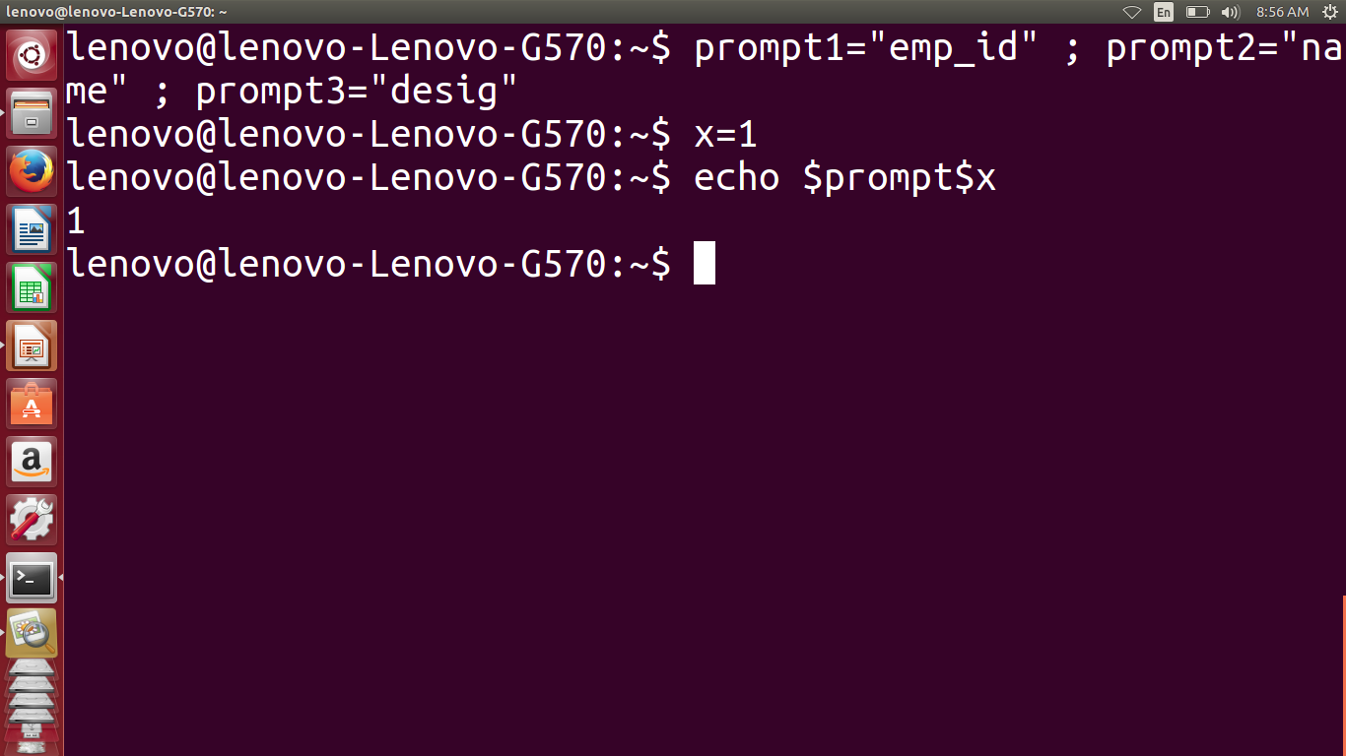

Slide 14
